Slide 1
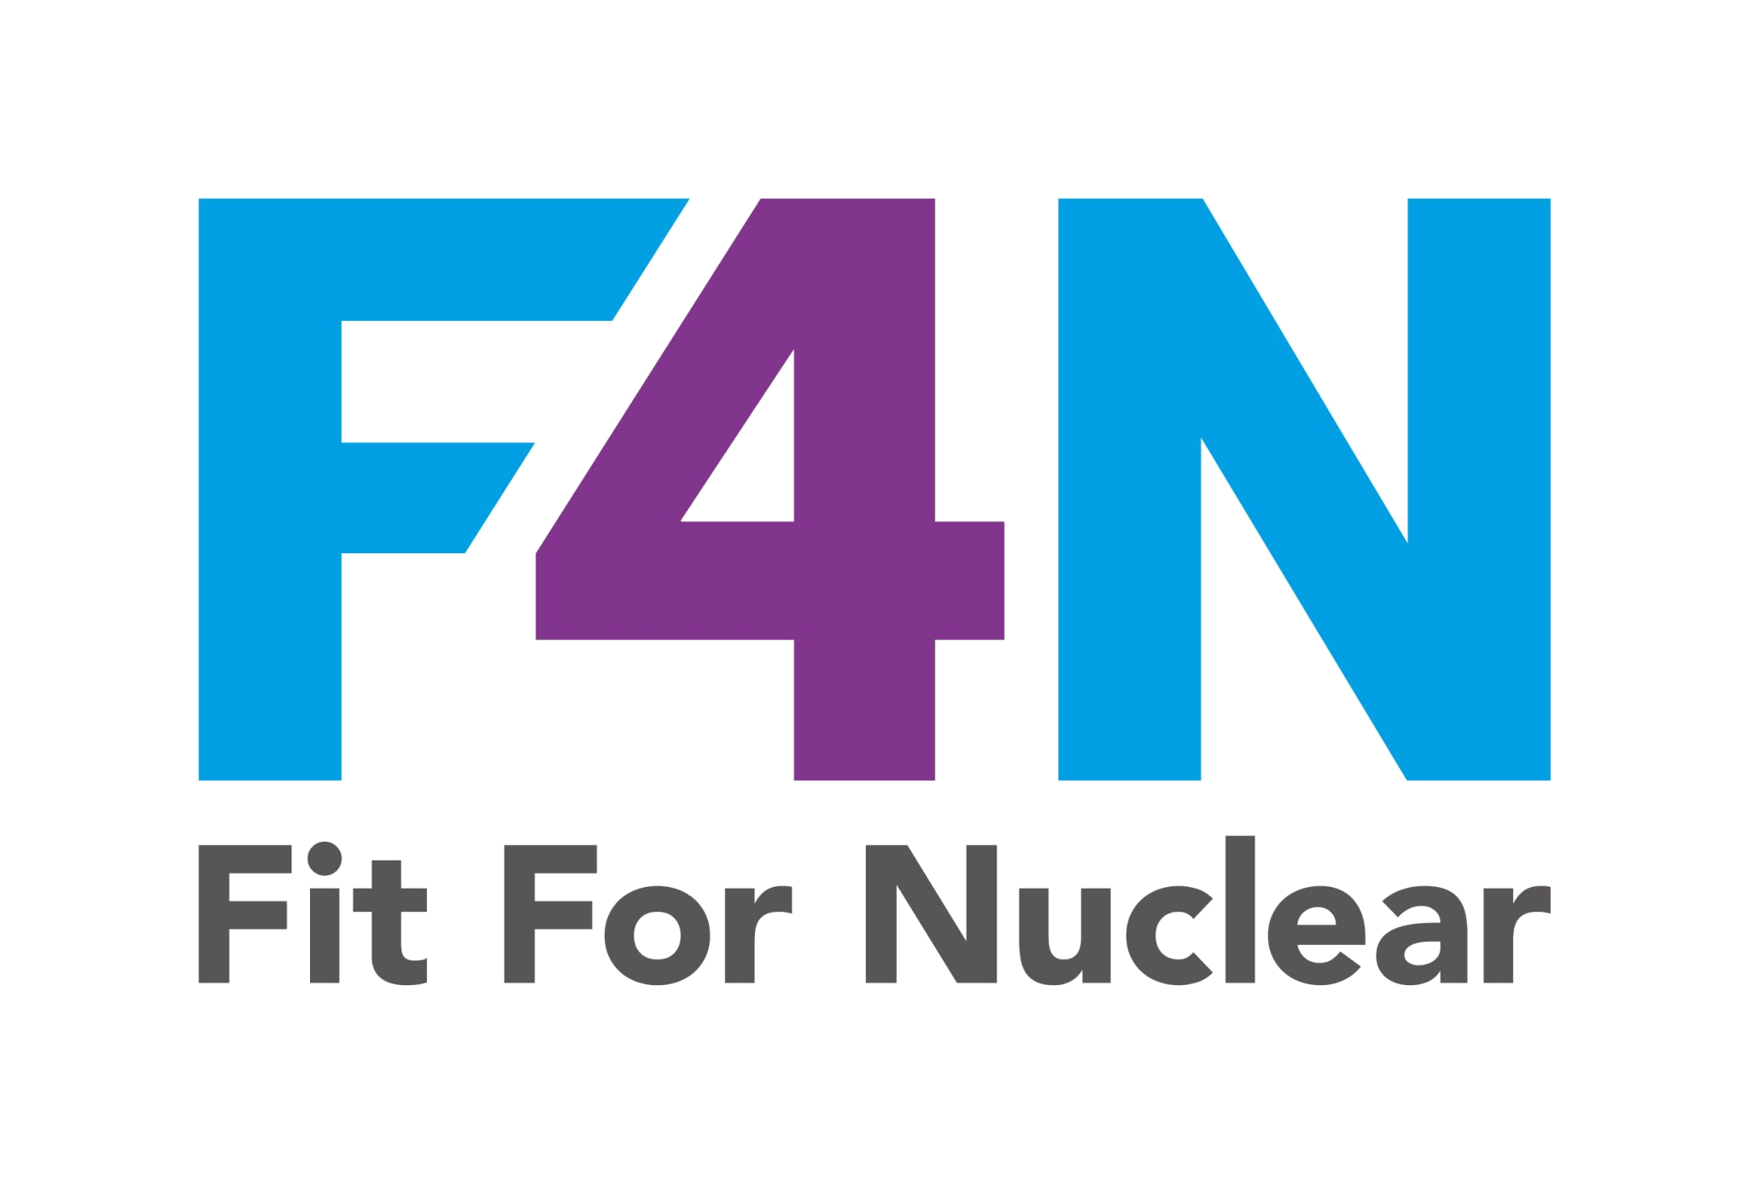

Supplier Qualification
and Oversight
NSS-06 | Nuclear Supply Chain Readiness
Nuc
Col
Nuclear Collaboration Ltd
F4N Programme | Fit For Nuclear
NucCol | Nuclear Collaboration Ltd · Fit For Nuclear Programme · Commercial in Confidence | 1

Slide 2
Session Overview
This session covers the full lifecycle of nuclear supplier qualification and ongoing oversight, from initial assessment through to performance management and escalation. Topics covered:
01
The Qualification Lifecycle
02
Pre-Qualification Assessment
Five stages from initial contact to approved supplier status
Questionnaire structure and minimum entry criteria
03
Audit Planning and Conduct
04
Finding Classification
Preparing, executing, and reporting supplier audits
Major NC, Minor NC, Observation, and Good Practice
05
ASL Management
06
Performance Monitoring
Maintaining the Approved Supplier List and approval boundaries
KPI frameworks and ongoing surveillance obligations
NucCol | Nuclear Collaboration Ltd · Fit For Nuclear Programme · Commercial in Confidence | 2

Slide 3
The Supplier Qualification Lifecycle
Nuclear qualification is a structured, evidence-based process. Each stage must be completed before progression to the next. Approval is always bounded by scope.
1
2
3
4
5
Initial Contact
Pre-Qualification
Audit / Assessment
Approval Decision
Ongoing Monitoring
Scope definition
NDA / confidentiality
Capability statement
PQQ submission
Document review
Minimum criteria check
Desk audit or site visit
Finding classification
CAPA agreement
Full / Conditional / Provisional
ASL entry
Scope boundary set
Performance KPIs
Surveillance programme
Re-qualification cycle
Key principle: Qualification approval is always bounded by scope. An approval to supply forgings does not extend to machined components, even from the same supplier.
NucCol | Nuclear Collaboration Ltd · Fit For Nuclear Programme · Commercial in Confidence | 3

Slide 4
Pre-Qualification Assessment
The Pre-Qualification Questionnaire (PQQ) establishes whether a supplier meets minimum entry criteria before audit resources are committed. Six assessment areas are evaluated.
Assessment Area | Minimum Criteria | Status
Quality Management | ISO 9001 certification or equivalent; quality manual; documented procedures | Mandatory
Nuclear Experience | Previous nuclear supply references; understanding of CFSI and traceability | Scored
Technical Capability | Process scope; equipment list; accreditations (NADCAP, UKAS, etc.) | Mandatory
Financial Stability | Two years audited accounts; credit rating; key customer dependency | Scored
Ethical and Legal | Modern Slavery Act compliance; export control awareness; sanctions screening | Mandatory
CFSI Controls | Approved sources policy; incoming inspection; obsolescence management | Scored
Assessment Area
Minimum Criteria
Status
Quality Management
ISO 9001 certification or equivalent; quality manual; documented procedures
Mandatory
Nuclear Experience
Previous nuclear supply references; understanding of CFSI and traceability
Scored
Technical Capability
Process scope; equipment list; accreditations (NADCAP, UKAS, etc.)
Mandatory
Financial Stability
Two years audited accounts; credit rating; key customer dependency
Scored
Ethical and Legal
Modern Slavery Act compliance; export control awareness; sanctions screening
Mandatory
CFSI Controls
Approved sources policy; incoming inspection; obsolescence management
Scored
NucCol | Nuclear Collaboration Ltd · Fit For Nuclear Programme · Commercial in Confidence | 4

Slide 5
Audit Planning and Conduct
A well-planned audit is a professional process, not an adversarial inspection. The objective is objective evidence of system effectiveness, not a gotcha exercise.
Preparation
Opening Meeting
Audit Execution
Closing Meeting
● Define audit scope and objectives
● Introduce audit team and purpose
● Document review: procedures vs practice
● Summarise findings and categories
● Compile audit checklist (clause-by-clause)
● Confirm scope, timing, and access
● Process walk-through and observation
● Agree CAPA timescales for each NC
● Request pre-audit documentation pack
● Explain finding classification system
● Records sampling (traceability, calibration)
● Confirm draft report issue date
● Confirm attendees and logistics
● Agree communication channel during audit
● Personnel interviews (objective evidence)
● Obtain signed attendance record
● Review previous audit findings
● Obtain guide / escort arrangements
● Note potential findings in real time
● Thank host and confirm next steps
Audit rule: Every finding must be supported by objective evidence. "I think they might not..." is not a finding. "Procedure REF-04 requires X; record REF-04/22 shows Y was done instead" is a finding.
NucCol | Nuclear Collaboration Ltd · Fit For Nuclear Programme · Commercial in Confidence | 5

Slide 6
Finding Classification
Consistent classification of audit findings is critical to credibility and to driving proportionate corrective action. These definitions align with ISO 19011 and industry practice.
Major NC
Definition:
Complete absence of a required system, process, or control; or a systemic failure affecting product quality or nuclear safety.
Response:
Immediate containment required. Supply hold until CAPA verified closed. Re-audit may be required.
Example:
No calibration system in place for measuring equipment used on nuclear components.
Minor NC
Definition:
Isolated failure to comply with a requirement where the overall system is in place and functioning.
Response:
CAPA required within agreed timescale (typically 30 days). Verification by document review.
Example:
Two calibration records missing from batch of 24 instruments; system and procedure are otherwise in place.
Observation
Definition:
A potential weakness or area for improvement that does not constitute a non-conformance at this time.
Response:
No formal CAPA required. Supplier encouraged to address. Monitored at next audit.
Example:
CFSI awareness training delivered verbally; no written records of completion maintained.
Good Practice
Definition:
An area where the supplier demonstrates performance that significantly exceeds requirements and could be shared as OPEX.
Response:
Documented and shared with Nuclear AMRC OPEX programme if supplier consents.
Example:
Supplier operates a supplier development programme for their own Tier 3 sub-contractors.
NucCol | Nuclear Collaboration Ltd · Fit For Nuclear Programme · Commercial in Confidence | 6

Slide 7
Approved Supplier List Management
The ASL is a living document, not a historical archive. Approval status must reflect current performance and capability. Unreviewed approvals become liabilities.
ASL Entry Requirements
Approval Status Types
● Supplier name, site address, and legal entity
Full Approval
All requirements met. No active major NCs. Next review within grade cycle.
● Approved scope (specific products or services only)
● Quality grade classification (NSC1 to NN)
Conditional Approval
Minor NCs open. Approved to supply within defined constraints pending closure.
● Approval date and expiry / next review date
● Current status: Approved / Conditional / Suspended / Removed
Provisional Approval
New supplier. First order placed before full audit cycle complete. Time-limited.
● Lead auditor and audit reference
Suspended
Active major NC or product quality failure. No new orders until resolved.
● CFSI risk category (Critical / Standard / Low)
● Any active corrective action references
Removed
Supplier has failed to remediate or has withdrawn. Historical record retained.
NucCol | Nuclear Collaboration Ltd · Fit For Nuclear Programme · Commercial in Confidence | 7

Slide 8
Supplier Performance Monitoring
Reactive management of supplier problems is too late for nuclear supply. A structured KPI framework enables early intervention before quality escapes occur.
KPI
Freq
Green (Target)
Amber (Monitor)
Red (Escalate)
On-Time Delivery
Monthly
>95%
90-95%
<90%
NCR Rate
Monthly
<2%
2-5%
>5%
Documentation Quality
Per delivery
First-time right
1 resubmit
>1 resubmit
Audit Cooperation
Per audit
Full access
Minor restriction
Access refused
CFSI Compliance
Per delivery
Full traceability
Minor gaps
Unverified source
Safety Culture
Annual
No concerns raised
Issues noted
Significant concern
NucCol | Nuclear Collaboration Ltd · Fit For Nuclear Programme · Commercial in Confidence | 8

Slide 9
Key Messages
Qualification is scope-bounded
Evidence, not assertion
Approval to supply one product does not confer approval for another. ASL entries must specify exact scope.
Every audit finding must reference a specific requirement and a specific piece of objective evidence. Opinion is not a finding.
Classification drives response
The ASL is a live document
Major NCs require immediate containment. Minor NCs require CAPA. Observations require monitoring. Proportionality is key.
Approvals expire. Performance changes. A supplier approved two years ago and never reviewed since is not a managed supplier.
Early intervention beats late reaction
Oversight protects the programme
KPI trends signal problems before quality escapes. Amber performance triggers conversation; red triggers formal escalation.
Surveillance and inspection obligations flow from the customer downward. Failure to oversee sub-tiers is a failure of the prime.
NucCol | Nuclear Collaboration Ltd · Fit For Nuclear Programme · Commercial in Confidence | 9

